Slide 1
CSE 486/586 Distributed Systems New Trends in Distributed Storage
Steve Ko
Computer Sciences and Engineering
University at Buffalo

Slide 2
Recap
Two important components in a distributed file service?
Directory service
Flat file service
NFS basic operations?
Client-server, where the server keeps & serves all files.
How does NFS improve performance?
Client-side caching
NFS client-side caching policy?
Write-through at close()
How does NFS cope with inconsistency?
Validation
NFS design choice for server-side failures?
Stateless server

Slide 3

New Trends in Distributed Storage
Geo-replication: replication with multiple data centers
Latency: serving nearby clients
Fault-tolerance: disaster recovery
Power efficiency: power-efficient storage
Going green!
Data centers consume lots of power

Slide 4
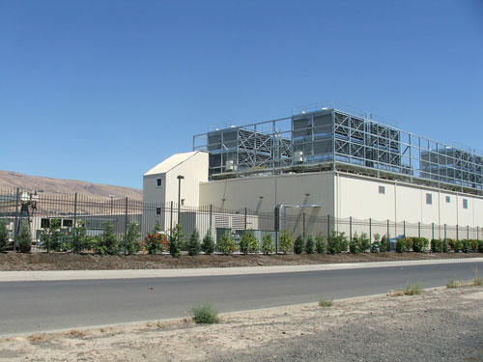
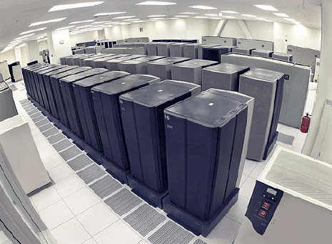
Data Centers
Buildings full of machines

Slide 5
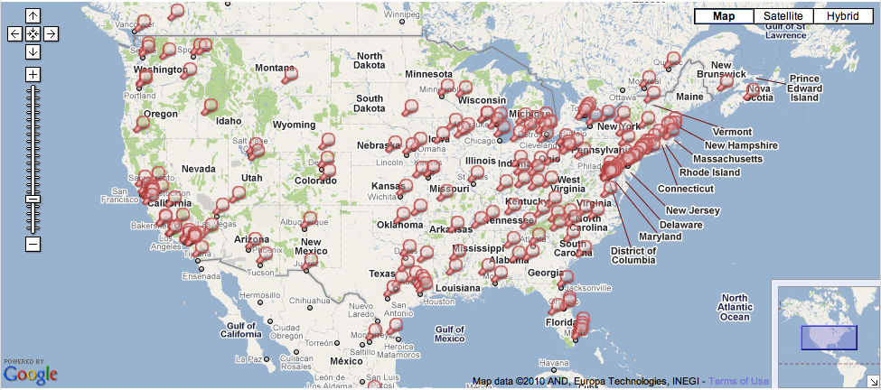
Data Centers
Hundreds of Locations in the US

Slide 6
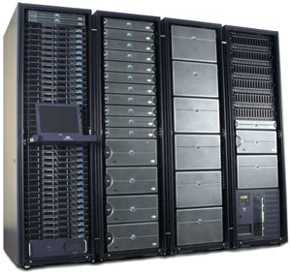
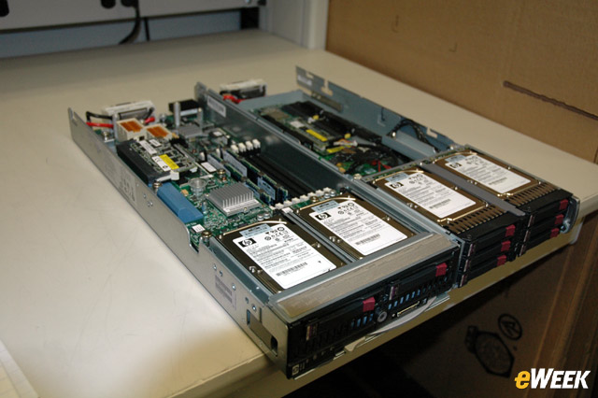
Inside
Servers in racks
Usually ~40 blades per rack
ToR (Top-of-Rack) switch
Incredible amounts of engineering efforts
Power, cooling, etc.

Slide 7
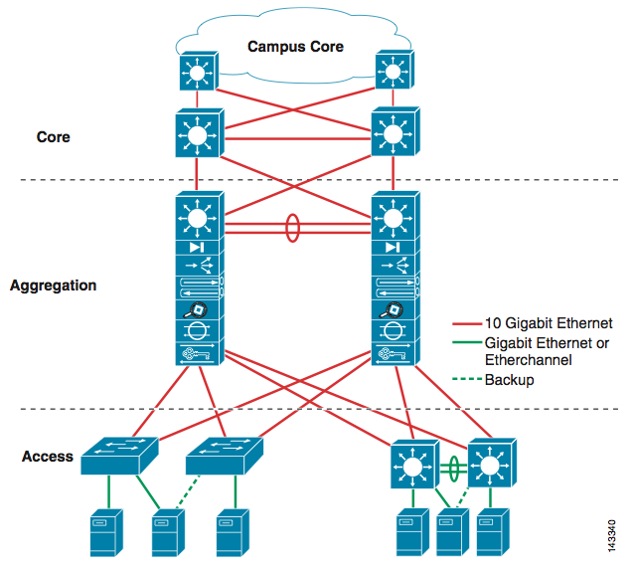
Inside
Network

Slide 8
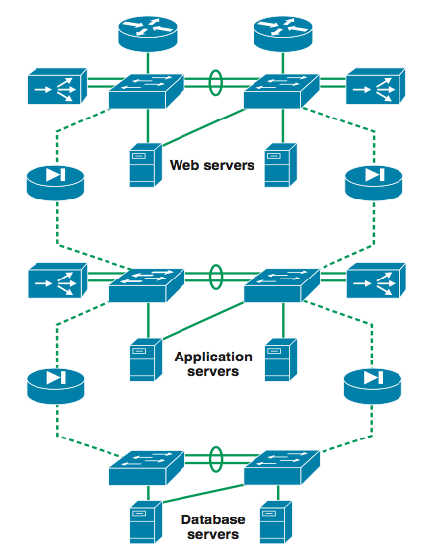
Inside
3-tier for Web services

Slide 9
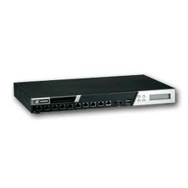
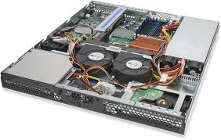
Inside
Load balancers
69.63.176.13
10.0.0.1
10.0.0.2
10.0.0.200
Web Servers

Slide 10
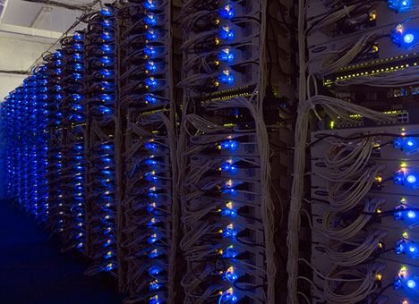
Example: Facebook
www.facebook.com
69.63.176.13
69.63.176.14
Oregon
69.63.181.11
69.63.181.12
North Carolina
69.63.187.17
69.63.187.18
69.63.187.19
California

Slide 11
Example: Facebook Geo-Replication
(At least in 2008) Lazy primary-backup replication
All writes go to California, then get propagated.
Reads can go anywhere (probably to the closest one).
Ensure (probably sequential) consistency through timestamps
Set a browser cookie when there’s a write
If within the last 20 seconds, reads go to California.
http://www.facebook.com/note.php?note_id=23844338919

Slide 12
CSE 486/586 Administrivia
Project 2 updates
Please follow the updates.
Please, please start right away!
Deadline: 4/13 (Friday) @ 2:59PM

Slide 13
Power Consumption
eBay: 16K servers, ~0.6 * 10^5 MWh, ~$3.7M
Akamai: 40K servers, ~1.7 * 10^5 MWh, ~$10M
Rackspace: 50K servers, ~2 * 10^5 MWh, ~$12M
Microsoft: > 200K servers, > 6 * 10^5 MWh, > $36M
Google: > 500K servers, > 6.3 * 10^5 MWh, > $38M
USA (2006): 10.9M servers, 610 * 10^5 MWh, $4.5B
Year-to-year: 1.7%~2.2% of total electricity use in US
http://ccr.sigcomm.org/online/files/p123.pdf
Question: can we reduce the energy footprint of a distributed storage while preserving performance?

Slide 14
One Extreme Design Point: FAWN
Fast Array of Wimpy Nodes
Andersen et al. (CMU & Intel Labs)
Coupling of low-power, efficient embedded CPUs with flash storage
Embedded CPUs are more power efficient.
Flash is faster than disks, cheaper than memory, consumes less power than either.
Performance target
Not just queries (requests) per second
Queries per second per Watt (queries per Joule)

Slide 15
Embedded CPUs
Observation: many modern server storage workloads do not need fast CPUs
Not much computation necessary, mostly just small I/O
I.e., mostly I/O bound, not CPU bound
E.g., 1 KB values for thumbnail images, 100s of bytes for wall posts, twitter messages, etc.
(Rough) Comparison
Server-class CPUs (superscalar quad-core): 100M instructions/Joule
Embedded CPUs (low-frequency, single-core): 1B instructions/Joule

Slide 16
Flash (Solid State Disk)
Unlike magnetic disks, there’s no mechanical part
Disks have motors that rotate disks & arms that move and read.
Efficient I/O
Less than 1 Watt consumption
Magnetic disks over 10 Watt
Fast random reads
<< 1 ms
Up to 175 times faster than random reads on magnetic disks

Slide 17
Flash (Solid State Disk)
The smallest unit of operation (read/write) is a page
Typically 4KB
Initially all 1
A write involves setting some bits to 0
A write is fundamentally constrained.
Individual bits cannot be reset to 1.
Requires an erasure operation that resets all bits to 1.
This erasure is done over a large block (e.g., 128KB), i.e., over multiple pages together.
Typical latency: 1.5 ms
Blocks wear out for each erasure.
100K cycles or 10K cycles depending on the technology.

Slide 18
Flash (Solid State Disk)
Early design limitations
Slow write: a write to a random 4 KB page → the entire 128 KB erase block to be erased and rewritten → write performance suffers
Uneven wear: imbalanced writes result in uneven wear across the device
Any idea to solve this?

Slide 19
Flash (Solid State Disk)
Recent designs: log-based
The disk exposes a logical structure of pages & blocks (called Flash Translation Layer).
Internally maintains remapping of blocks.
For rewrite of a random 4KB page:
Read the surrounding entire 128KB erasure block into the disk’s internal buffer
Update the 4KB page in the disk’s internal buffer
Write the entire block to a new or previously erased physical block
Additionally, carefully choose this new physical block to minimize uneven wear

Slide 20
Flash (Solid State Disk)
E.g. sequential write till block 2, then random read of a page in block 1
1) Read to buffer
2) Update the page
3) Write to a different block location
4) Garbage collect the old block
Write
Block 0
Write
Block 0
Write
Block 1
Write
Free
Block 1
Write
Block 2
Write
Block 2
Write
Block 1
Logical Structure
Physical Structure

Slide 21
FAWN Design
Wimpy nodes based on PCEngine Alix 3c2
Commonly used for thin clients, network firewalls, wireless routers, etc.
Single-core 500 MHz AMD Geode LX
256MB RAM at 400 MHz
100 MBps Ethernet
4 GB Sandisk CompactFlash
Power consumption
3W when idle
6W under heady load

Slide 22
FAWN Node Organization
FAWN nodes form a key-value storage using consistent hashing.
But, there are separate front-ends that manages the membership of back-end storage nodes
N3
Partition 0
Partition 0 & 1
Front-end 0
Partition 3
N2
N0
Partition 2 & 3
Front-end 1
Partition 2
Partition 1
N1

Slide 23
FAWN Replication
Chain replication for per-key consistency
Sequential consistency if clients issue requests one at a time.
Updates
Queries
Replies
N0
N1
N2
Head
Tail

Slide 24
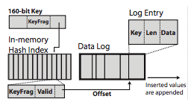
FAWN Data Storage (FAWN-DS)
Small in-memory hash table with persistent data log
Due to the small RAM size of wimpy nodes
Index bits & key fragmentation to find the actual data stored in flash (might need two flash reads)

Slide 25
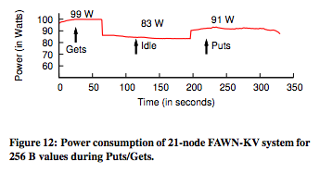
Power Consumption Measurement
Compare this to a typical server (~900W)

Slide 26
Performance Measurement
1KB read
Raw file system: 1424 queries per second
FAWN-DS: 1150 queries per second
256B read
Raw file system: 1454 queries per second
FAWN-DS: 1298 queries per second

Slide 27
Summary
New trends in distributed storage
Wide-area (geo) replication
Power efficiency
One power efficient design: FAWN
Embedded CPUs & Flash storage
Consistent hashing with front-ends
Chain replication
Small in-memory hash index with data log

Slide 28
Acknowledgements
These slides contain material developed and copyrighted by Indranil Gupta (UIUC).

